Slide 1
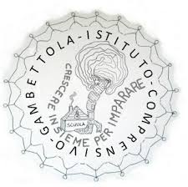
ERASMUS PLUS – KA2 – A.S. 2019/2021
My Future Job Through STEAM
Scuola Secondaria di primo grado «Ippolito Nievo» Gambettola Italy

Slide 2
TRAVELLING …
… LEAVES YOU SPEECHLESS. WE TRAVEL TO SEEK OTHER PLACES, OTHER LIVES, OTHER SOULS, TO UNDERSTAND OURSELVES.
«The world is a book and those who do not travel read only a page» Saint Augustine

Slide 3
PARTNERS
DANEMARK - ODENSE
SPAIN –MEMBRILLA
PORTUGAL – ALFÂNDEGA DA FÉ
TURKEY - ANTALYA
ITALY -GAMBETTOLA

Slide 4
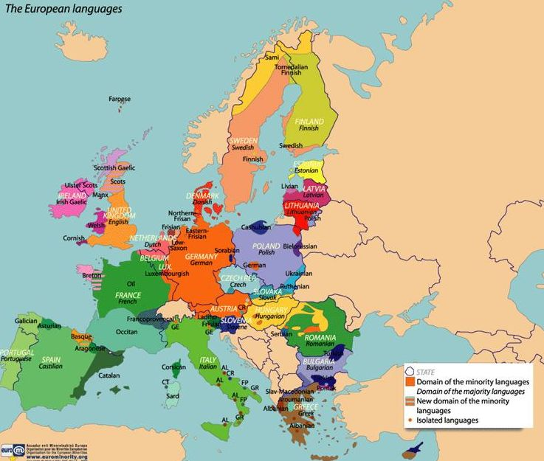

Slide 5
WHAT’S ERASMUS +?
The actions under KA2 make it possible for organizations from different participating countries
to work together;
to develop, share, test and transfer best and innovative practices and innovative approaches in the fields of education, training and youth;
to promote the recognition and validation of knowledge, skills, and competences;
to promote equity, diversity, and inclusion in learning;
to promote entrepreneurship, active citizenship and cultural exchanges among young people.

Slide 6
THE MAIN GOALS OF THE PROJECT
1
To develop teachers' integrated teaching skills on STEAM subjects by raising their awareness on the interdisciplinary relationships between Science, Technology, Engineering, Art and Mathematics
2
3
To engage students in STEAM activities to develop their skills of creativity, critical thinking, collaborative problem solving, learning to learn and initiative and entrepreneurial competences, to encourage students to be involved in various STEAM activities
To introduce students (in particular girls) to STEAM disciplines via motivating them in STEAM careers and prepare them for further studies in STEAM, to strengthen the schools’ STEAM curriculum

Slide 7
TANGIBLE RESULTS
Project web site/ Brochure, Roll-up
Moodle Platform eTwinning project Blogs
Animation Video WOMEN in STEAM
Digital Storytelling ‘WHY SCIENTISTS NEED ART TRAINING?’ 2 Newsletters
e-Brochure THE BEST 20 STEAM JOBS
Guiding Principles for long term STEAM education

Slide 8
LET’S START!
Let’s encourage our school community to be more open-minded,
using ICT, foreign languages, communication and teamwork skills
across EUROPE!

